Slide 1

Reporting and Analyzing Cash Flows
12
Chapter
UAA – ACCT 201 Principles of Financial Accounting Dr. Fred Barbee

Slide 2

IS FUN!
Chapter 12
Day One
ACCT 201

Slide 3
Chapter 12 - Day 1 - Agenda
Topic | LO | Read | HW
Basics of Cash Flow Reporting | C1, C2, C3, C4, P1 | 524-530 | QS1, QS2, E4
Cash Flows From Operating Activities | P2 | 531-538 | E1, E2, E5
No Homework Due Today!

Slide 4

The Statement of Cash Flows
Notes:
The Statement of Cash Flows is the fourth of the four primary financial statements.
It is equal in status to the income statement and balance sheet by way of official pronouncement, although not by tradition.

Slide 5
Statement of Changes in Financial Position
Predecessor to the Statement of Cash Flows
Notes:
The Statement of Changes in Financial Position - AKA the “Funds Flow Statement,” was the predecessor to the statement of cash flows.
First, lets see a bit of history concerning the statement of changes to see why the SCF was necessary.

Slide 6
Statement of Changes in Financial Position . . .
The Accounting Principles Board (APB) in Opinion #19 prescribed that the Statement of Changes in Financial Position (SCFP) be presented for each period in which an income statement was shown.
Notes:
Why did we need the SCF? Or, what was wrong with the statement of changes in financial position? Obviously there was some problem(s) or it would still be around.
Well, you’re right ==> let’s see what the problems were . . .

Slide 7
The Statement of Changes in Financial Position
Problems limiting its usefulness.

Slide 8

Problems . . .
Too much flexibility in the definition of “funds.”
ACCT 201 ACCT 201 ACCT 201
Notes:
The Statement of Changes in Financial Position reported on changes in “funds” and Opinion No. 19 allowed for considerable flexibility in the definition of funds.

Slide 9


Definition of Funds . . .
“Funds” were defined as . . .
  Cash
  Net liquid assets
  All balance sheet items
  Working capital
Notes:
For example . . .
Many firms interpreted funds to mean working capital - that is – CA - CL.
Others, in fact a majority of firms by 1986, interpreted funds to mean cash or near-cash.

Slide 10
Introduction To Financial Accounting
The statement of changes in financial position is still in its infancy as a required financial report.
It is undergoing experimentation as more experience is being gained with it.
There has been long-standing disagreement on the concept and format of the changes statement.
Horngren, 1981

Slide 11
Introduction To Financial Accounting
By far the most popular approach has been to view it as an explanation of why working capital (excess of current assets over current liabilities) has changed for a given period.
Horngren, 1981

Slide 12
Intermediate Accounting
Income statements and balance sheets have a sharp focus regarding their purposes, but changes statements have a less clear focus that differs from entity to entity.
Kieso & Weygandt, 1983

Slide 13
Intermediate Accounting
Some entities focus on a change in cash;
Others focus on a change in net liquid assets (Cash + Receivables – Current Liabilities).
Kieso & Weygandt, 1983

Slide 14
Intermediate Accounting
Others focus on all the balance sheet items (all financial resources approach).
Still others focus on the working capital approach.
Kieso & Weygandt, 1983

Slide 15
Problems . . .
2
Completeness of the Statement
ACCT 201 ACCT 201 ACCT 201
Notes:
The report, while better than nothing, did not provide sufficient information as to the cash flows of a firm.
We will see a dramatic example of that in just a few minutes.

Slide 16
Completeness . . .
The statement provided for information on . . .
  Sources (inflows), and
  Uses (outflows)
Notes:
The report did not provide information on cash flows for the three important functions (activities) of a business . . .
1. Operating;
2. Financing; and
3. Investing

Slide 17

Problems . . .
Ability of the firm to generate cash.
ACCT 201 ACCT 201 ACCT 201
Notes:
The Funds Statement, even when prepared on a cash basis, did not provide a complete and clear picture of a firm’s ability to generate positive cash flows.
More on that momentarily. Let’s take a slight detour ➔ “Why is a knowledge of a firm’s cash flows so important?”

Slide 18

Importance . . .
ACCT 201 ACCT 201 ACCT 201
. . . of Cash Flows
ACCT 201 ACCT 201 ACCT 201

Slide 19
Importance of Cash Flows
Cash is needed . . .
  To pay suppliers
  To pay loans
  To pay employees
  To pay taxes
  Purchase new equipment

Slide 20
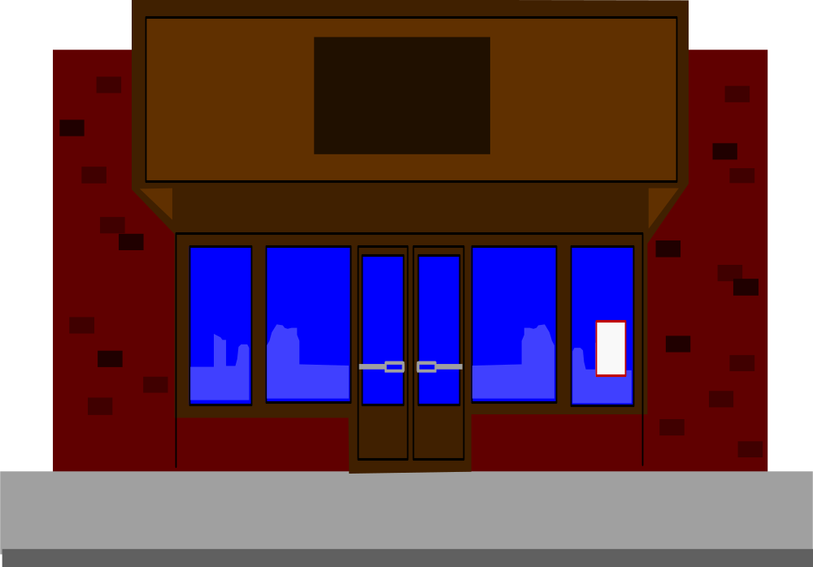

W. T. Grant Co.
“Retailing With A Difference”
A Classic Example . . .

Slide 21
The W. T. Grant Co.
The W. T. Grant Company was the nation’s largest retailer when it filed for protection under Chapter XI of the bankruptcy act on October 2, 1975.
Four months later the company was liquidated.

Slide 22
What Happened?
ACCT 201 ACCT 201 ACCT 201
ACCT 201 ACCT 201 ACCT 201

Slide 23
Chain of Events . . .
1906: First store opened
1928: Public stock offering
1950: Had 500 stores
1963: W. T. Grant retired
1969: Opened 410 new stores
1973: Stock sold at 20 times earnings

Slide 24
Chain of Events . . .
1974: Borrowed $600 million
1974: Stock price was at $2 from a high of $71
1974: Hired new president
1975: Opened 6 new stores
1975: Closed 107 stores and laid off 7,000 employees

Slide 25
Chain of Events . . .
Oct. 1975: Chairman, Senior VP and all outside directors resigned - FILED FOR CHPT 11 BANKRUPTCY.
Feb. 1976: Judge ordered liquidation in 60 days
Apr. 1976: Company adjudicated as a bankrupt.
Notes:
Why couldn’t creditors and stockholders see Grant’s impending problems any sooner?
Let’s examine a chart of net income and working capital provided by operations to see if it will shed any light on this problem.

Slide 26
W. T. Grant
Millions of Dollars
Working Capital Provided By Operations
40
20
Net Income
0
1966
1968
1970
1972
1974
-20
Cash Flow Provided by Operations
-40
-100
ACCT 201 ACCT 201 ACCT 201
Notes:
A careful analysis of the company’s cash flows would have revealed the problems as much as a decade before the collapse.
This graph reveals that although both working capital and net income remained positive through 1974, cash flow provided by operations was almost consistently negative from 1966 to 1975.

Slide 27
The Statement of Cash Flows
Where Does it Fit in?
ACCT 201 ACCT 201 ACCT 201
Notes:
Most accountants will agree that the Income Statement and the Balance Sheet disclose valuable information to investors, creditors, managers and a host of other users of such information.

Slide 28

The Balance Sheet
Discloses information concerning the economic resources, financial obligations, and stock-holders’ equity of a business enterprise at a specific point in time.
Notes:
A comparison of beginning and end-of-period balance sheets will reveal changes in specific asset or liability accounts, but the full details of the changes in these balances is obscured and very difficult to detect because of offsetting transactions.

Slide 29
Examine Two Balance Sheets
Property Plant
and Equipment
1992
$50,000
Property Plant
and Equipment
1993
$75,000
Difference
$25,000
What caused the change?
1. Purchase $25,000 of Equipment? 2. Sell/Buy with net change of $25,000?
The Balance Sheet doesn’t say!
ACCT 201 ACCT 201 ACCT 201
Notes:
Could we go to the income statement to find out what happened?
Let’s see . . .

Slide 30

The Income Statement
Focuses on the results of operations and reveals a firm’s revenues and expenses for a given accounting period.
Notes:
The income statement doesn’t help either because . . . neither the balance sheet nor the income statement are designed to provide that kind of information.

Slide 31
Inherent Limitations
Neither the Balance Sheet nor the Income Statement disclose specific events and transactions that occurred during the period.

Slide 32
Enter . . .
The Statement of Cash Flows
Notes:
The accounting profession, therefore, requires another report to improve the financial disclosures of a business enterprise - The Statement of Cash Flows.

Slide 33

The Statement of Cash Flows . . .
“Bridges the Gap” between Balance Sheets
Notes:
The Statement of Changes in Financial Position – the predecessor of the SCF – was often referred to as the “Where got, where gone statement.”
(i.e., where the resources came from and where they went!)

Slide 34
ACCT 201 ACCT 201 ACCT 201
The Statement of Cash Flows
As A Bridge Between Two Balance Sheets
Statement of Cash Flows
For Period Ending
12/31/02
Balance
Sheet
12/31/01
Income Statement
For Period Ending
12/31/02
Balance
Sheet
12/31/02
ACCT 201 ACCT 201 ACCT 201

Slide 35

Statement of Cash Flows
Is designed to assist financial statement users in assessing the . . .
  Amounts,
  Timing, and
  Uncertainty
Of future cash flows.
Notes:
In this regard, the SCF can provide answers to such questions as:
How a company is able to pay dividends when it had a net loss; and
Why a company is short of cash despite increased earnings.

Slide 36
Statement of Cash Flows
The SCF can provide answers to questions such as . . .
  How is a company able to pay dividends when it had a net loss?
  Why is a company short of cash despite increased earnings?
Notes:
The SCF may show, for example, that external borrowings or the issuance of capital stock provided the cash from which dividends were paid even though a net loss was reported for the year.

Slide 37

Statement of Cash Flows
Basically the SCF tells us . . .
  Where the cash came from;
  Where the cash went; and
  The net change in cash.

Slide 38
The Statement of Cash Flows
ACCT 201 ACCT 201 ACCT 201
Let’s define . . .
ACCT 201 ACCT 201 ACCT 201

Slide 39

The Statement of Cash Flows is:
A primary financial statement that reports
  The cash receipts,
  The cash payments, and
  Net change in cash
Resulting from the
  Operating,
  Investing, and
  Financing activities
Of an enterprise during a period in a format that reconciles the beginning and ending cash balances.
Notes:
Reporting the net increase or decrease in cash is considered useful because investors, creditors, and other interested parties want to know and can generally comprehend what is happening to a company’s most liquid resource - it’s cash.

Slide 40
FASB Statement . . .
ACCT 201 ACCT 201 ACCT 201
No. 95
Objectives of the SCF
ACCT 201 ACCT 201 ACCT 201
Notes:
FASB Statement No. 95 sets forth the objectives of the statement of cash flows.

Slide 41

Purposes of the SCF . . .
To help investors, creditors, and others to assess four things . . .
ACCT 201 ACCT 201 ACCT 201

Slide 42

Purposes of the SCF . . .
The ability of the firm to generate positive future cash flows.
ACCT 201 ACCT 201 ACCT 201

Slide 43

Purposes of the SCF . . .
The ability of the firm to meet its obligations, its ability to pay dividends, and its need for external financing.
ACCT 201 ACCT 201 ACCT 201

Slide 44

Purposes of the SCF . . .
The reasons for differences between net income and associated cash receipts and payments.
ACCT 201 ACCT 201 ACCT 201

Slide 45

Purposes of the SCF . . .
The effect on a firm’s financial position of both its cash and noncash investing and financing transactions during the period.
ACCT 201 ACCT 201 ACCT 201

Slide 46
Major Inflows and Outflows of Cash
Inflows (Increases) of Cash
-Sales of Goods and Services
-Sales of Investments
-Sales of PP&E
-Issuance of Debt
-Issuance of Stock
Beginning
Cash
Change in Cash
Ending
Cash
Outflows (Decreases) of Cash
-Inventory and Expenses
-Investments
-Property, Plant & Equip
-Debt, Stock
-Dividends

Slide 47

Sections of the Statement of Cash Flows
Notes:
Recall that one of the short-comings of the Statement of Changes in Financial Position was its inability to differentiate between:
1. Operating;
2. Investing; and
3. Financing
activities during the period.

Slide 48
Cash Flows From . . .
Financing Activities
Operating Activities
Investing Activities

Slide 49

Cash Flows . . .
From Operating Activities

Slide 50
Operating Activities . . .
General Thrust . . .
  Activities primarily related to the production and sale of goods and services and . . .
  That enter into the determination of income for the firm.

Slide 51


Operating Activities
Inflows
  Receipts from customers.
  Cash dividends received.
  Interest from borrowers.
  Other.
Outflows
  Salaries and wages.
  Payments to suppliers.
  Taxes and fines.
  Interest paid to lenders.
  Other.
ACCT 201 ACCT 201 ACCT 201

Slide 52

Cash Flows . . .
From Investing Activities
Notes:
Report cash received and paid as a result of the sale and purchase of investments . . .

Slide 53
Investing Activities . . .
Report cash received and paid as a result of the sale and purchase of investments . . .
  Purchase/Sale of plant assets
  Purchase/Sale of debt or Equity securities
  Making/Collecting Loans to others

Slide 54
Investing Activities . . .
General Thrust . . .
  Activities that involve investment of a company’s resources . . .
  i.e., investing activities involve cash flows generally resulting from changes in long-term assets.

Slide 55
Investing Activities
Inflows
Selling long-term productive assets.
Selling equity investments.
Collecting of principal on loans.
Other.
Cash Flows from Investing Activities
+
ACCT 201 ACCT 201 ACCT 201

Slide 56
Investing Activities
Inflows
Selling long-term productive assets.
Selling equity investments.
Collecting of principal on loans.
Other.
Cash Flows from Investing Activities
+
Outflows
Purchase long-term productive assets.
Purchase equity investments.
Purchase debt investments.
Make loans.
_
ACCT 201 ACCT 201 ACCT 201

Slide 57

Cash Flows . . .
From Financing Activities
Notes:
Report cash received and paid as a result of both . . .
1. Debt, and
2. Equity financing.

Slide 58
Financing Activities
Inflows
Issuing its own equity securities.
Issuing bonds and notes.
Issuing short-term and long-term liabilities.
Cash Flows from Financing Activities
+
ACCT 201 ACCT 201 ACCT 201

Slide 59
Financing Activities
Inflows
Issuing its own equity securities.
Issuing bonds and notes.
Issuing short-term and long-term liabilities.
Cash Flows from Financing Activities
+
Outflows
Pay dividends to shareholders.
Purchase treasury stock.
Repay loans.
Cover withdrawals by owners.
_
ACCT 201 ACCT 201 ACCT 201

Slide 60
Noncash Investing & Financing
Items requiring separate disclosure:
  Retirement of debt by issuing equity stock.
  Conversion of preferred stock to common.
  Lease of assets using a capital lease.
  Purchase of long-term asset by issuing a note or bond.
  Exchange of noncash assets for other noncash assets.
ACCT 201 ACCT 201 ACCT 201

Slide 61
Sections - Recap . . .
Operating Activities usually relate to current items.
Investing activities usually relate to noncurrent assets.
Financing Activities usually relate to noncurrent liabilities and stockholders’ equity.

Slide 62
Statement of Cash Flows
Cash Received
From Operating
Activities
Cash Received
From Investing
Activities
Cash Received
From Financing
Activities
Cash and Cash Equivalents
Cash Disbursed
For Operating
Activities
Cash Disbursed
For Investing
Activities
Cash Disbursed
For Financing
Activities

Slide 63
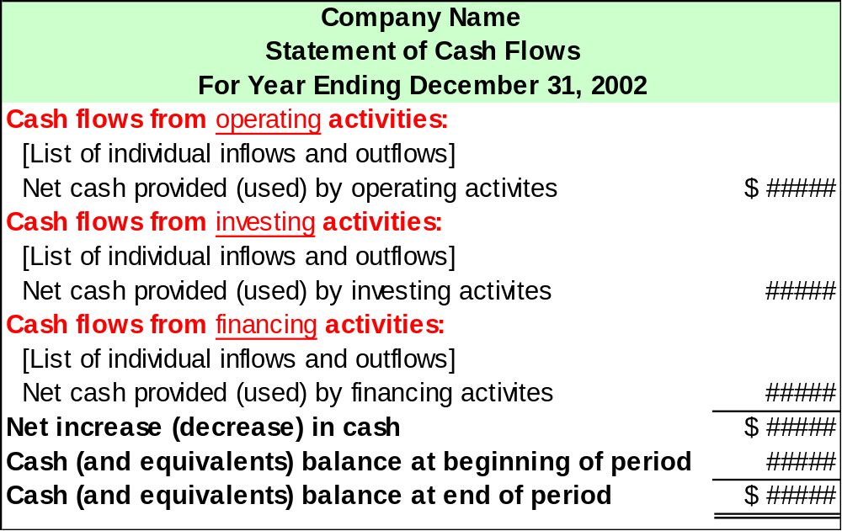
Exh.
12.5

